Slide 1
Team SeismoMech Technology Review
Guiliang Zheng, Manuela Köpfli, Callum Keddie, Shreeya Gadgil, Yash Bhangale

Slide 2
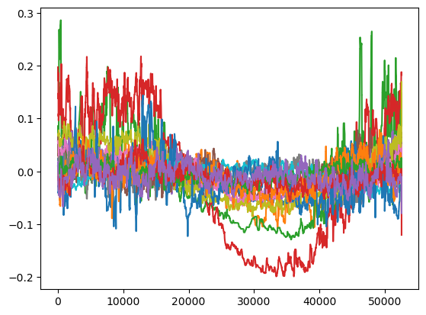
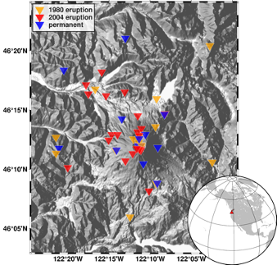
Background
Analysis of seismology data (from Mt. St. Helens)
Mt St Helens data ranges from 2000 to 2022, covering the notable eruption in 2004
Our software can be used on any seismological data
Output of this project involves plots of seismological data over time and geospatial data to be displayed over a map
We want a technology/library that will allow us to easily display our data over a map
Notes:
Correlation of Seismic Attenuation and Magma Extrusion, Analysis of Changing Climatic Patterns

Slide 3

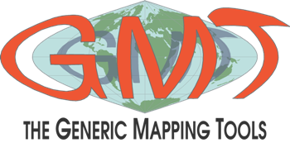
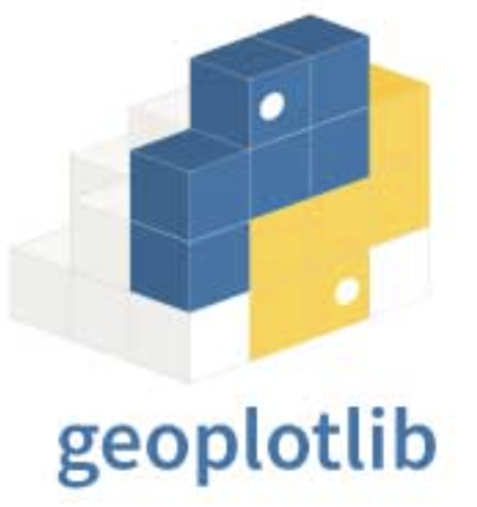
Technologies to consider
Plotly is an open-source data visualization library that provides a platform for creating interactive, web-based charts and graphs. It also provides an online platform called Plotly Chart Studio, where users can create and share interactive plots and dashboards.
PyGMT is a library for processing geospatial and geophysical data and making publication-quality maps and figures. It provides a Pythonic interface for the Generic Mapping Tools (GMT), a command-line program widely used across the Earth, Ocean, and Planetary sciences and beyond.
Geoplotlib is an open-source python library for visualizing geographic data. It is a simple API that produces visualizations on top of OpenStreetMap tiles.
Geoplotlib
Notes:
Key features of Plotly is its ability to generate interactive plots, which means users can zoom, pan, hover over data points for additional information, and export or save charts in various formats. (Interactive plot)
Key features of PyGMT include support for various map projections, the ability to plot data with different symbols and colors, contouring, adding text and labels, and overlaying coastlines, rivers, and other geographic features.
It allows the creation of dot maps, data density estimators, spatial plots, and shapefiles, among many other spatial visualizations. (urban and basic functionality)

Slide 4
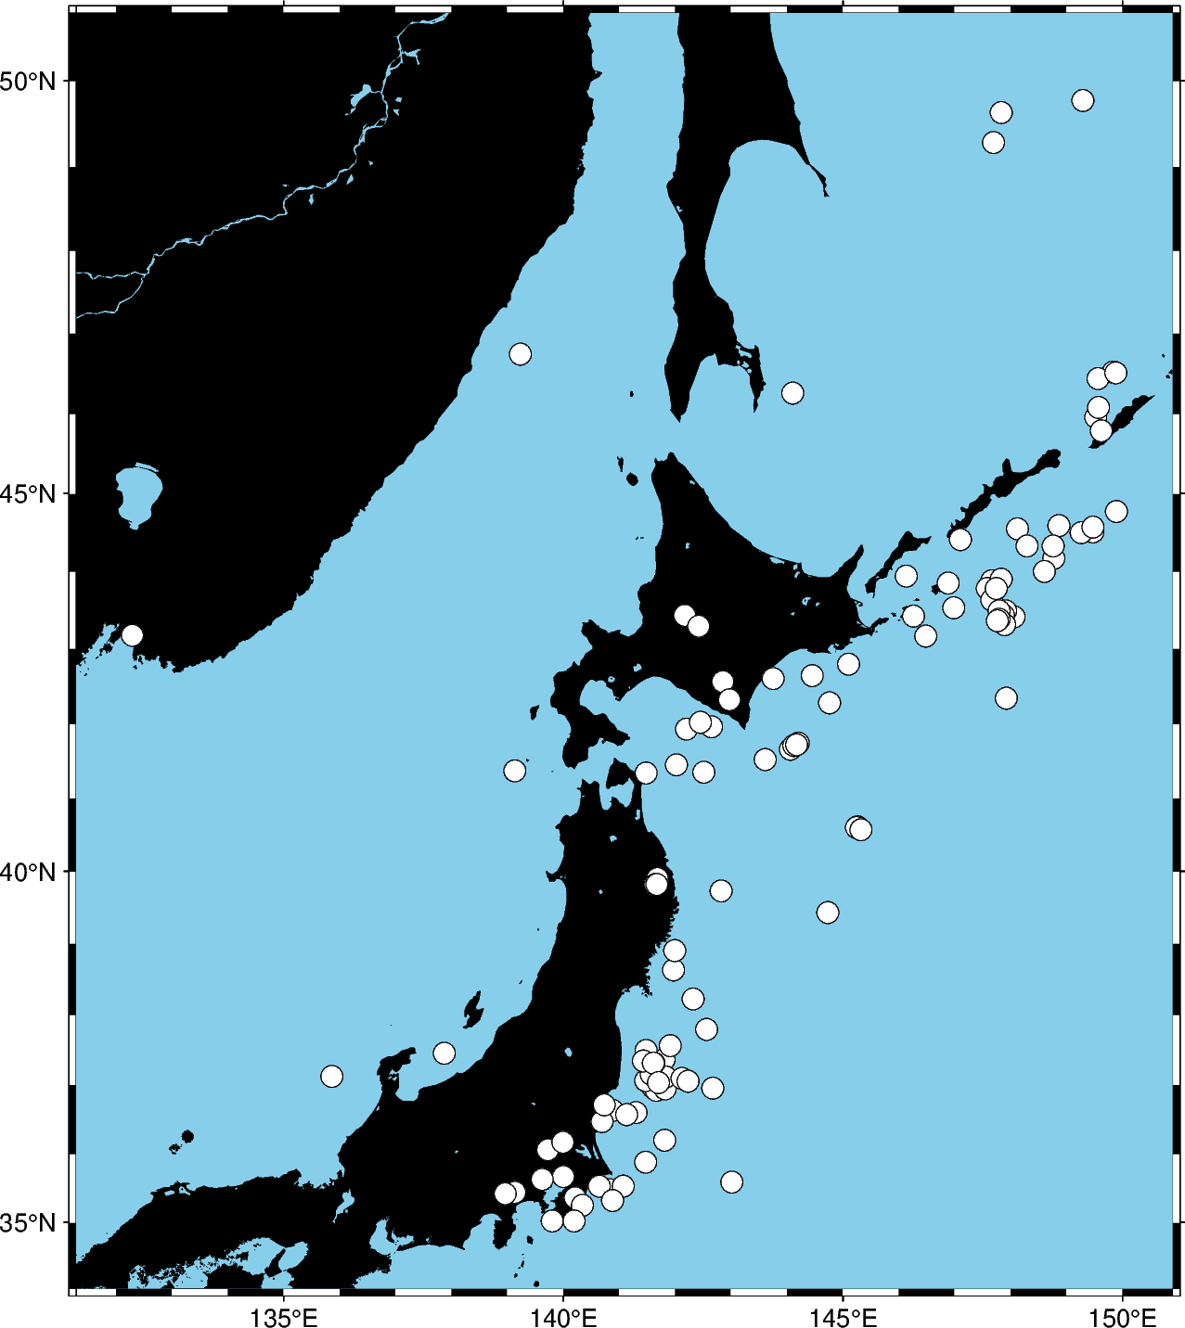
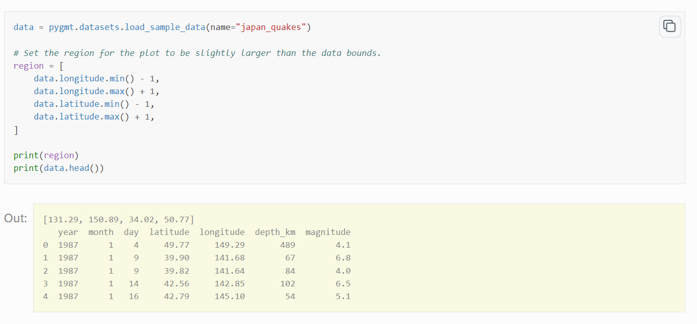
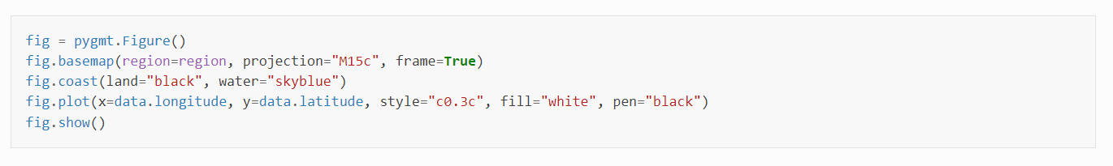
Choice and how it works: PyGMT
Define Region to plot specific maps.
Different types of projections can be used.
Data is plotted using coordinates.
*Code and image from PyGMT documentation

Slide 5
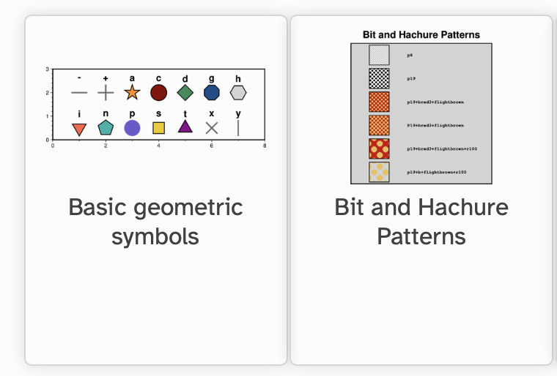
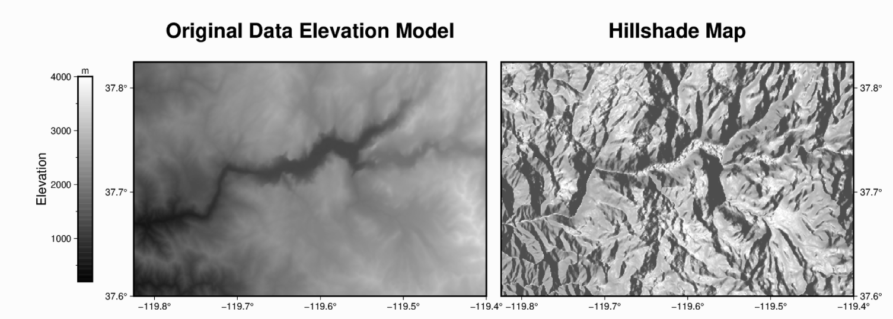
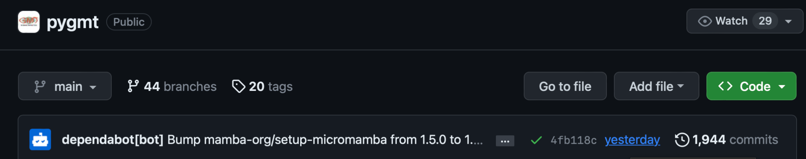

Appeal of choice
Familiarity
Made to plot maps (legend, orientation,...)
Many possibilities to adjust to your figure
Able to load DEM and calculate hillshade
We do not need an interactive map

Slide 6

Drawbacks of PyGMT
Command Line Interface
Limited Interactivity
Dependency on GMT
Limited Integration with other python libraries

Slide 7
Plotly
Geoplotlib
Less suitable for static, publication-quality maps compared to PyGMT.
Customization options, especially in free versions, might be limited
Limited customization and advanced geospatial capabilities compared to PyGMT and Plotly.
Best suited for simple, straightforward map visualizations.

Slide 8
Plotly is a technical computing company, that develops online data analytics and visualization tools. Plotly provides online graphing, analytics, and statistics tools for individuals and collaboration, as well as scientific graphing libraries for Python, R, MATLAB, Perl, Julia, Arduino, JavaScript^{[1]} and REST.

Slide 9
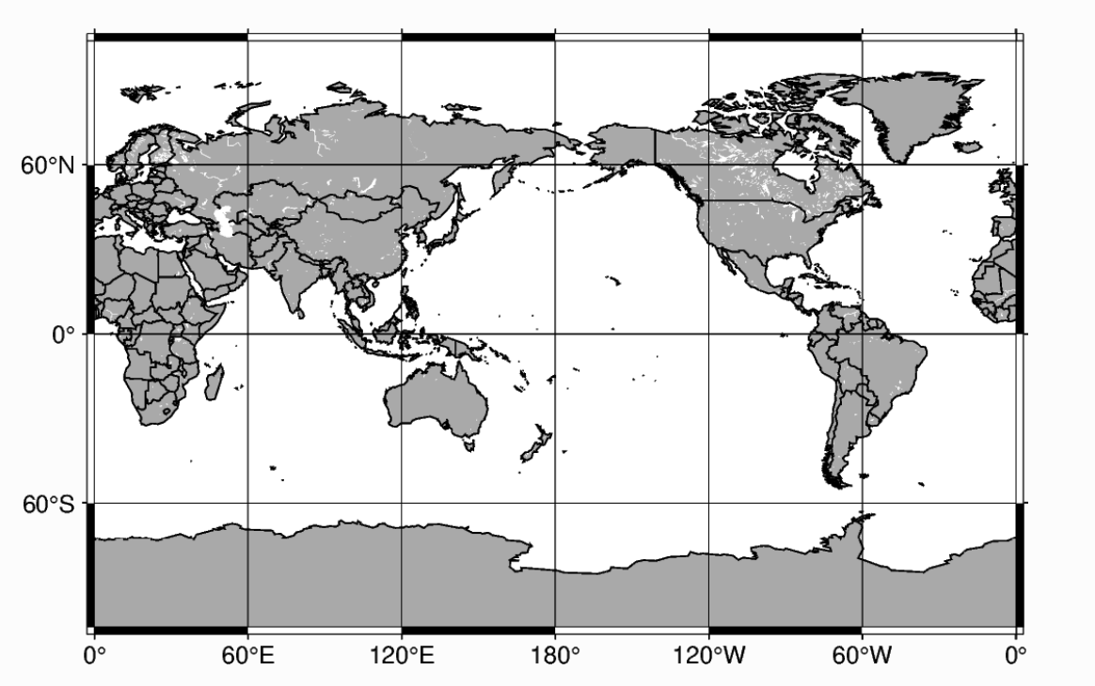
Choice and Summary of how it works: PyGMT
import pygmt
fig = pygmt.Figure()
fig.coast(
region="g",
projection="Cyl_stere/12c",
land="darkgray",
water="white",
borders="1/0.5p",
shorelines="1/0.5p",
frame="ag",
)
fig.show()
*Code and image from PyGMT documentation

Slide 10
PyGMT is a library for processing geospatial and geophysical data and making publication-quality maps and figures. It provides a Pythonic interface for the Generic Mapping Tools (GMT), a command-line program widely used across the Earth, Ocean, and Planetary sciences and beyond.

Slide 11
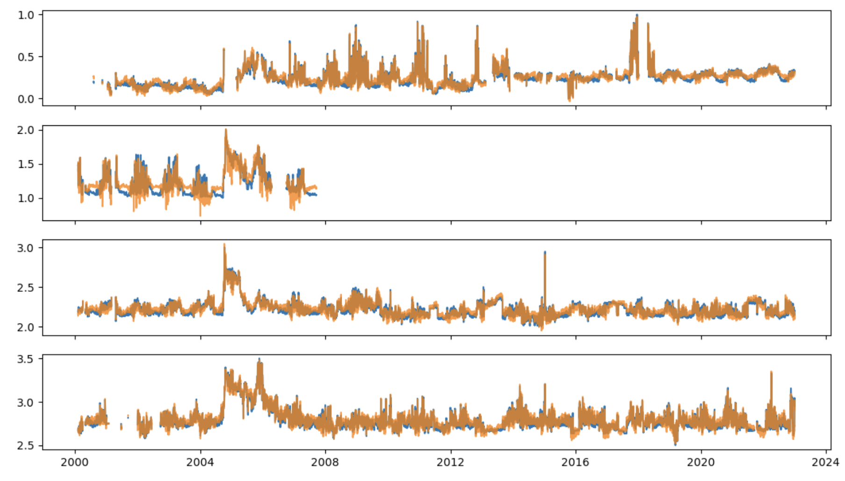
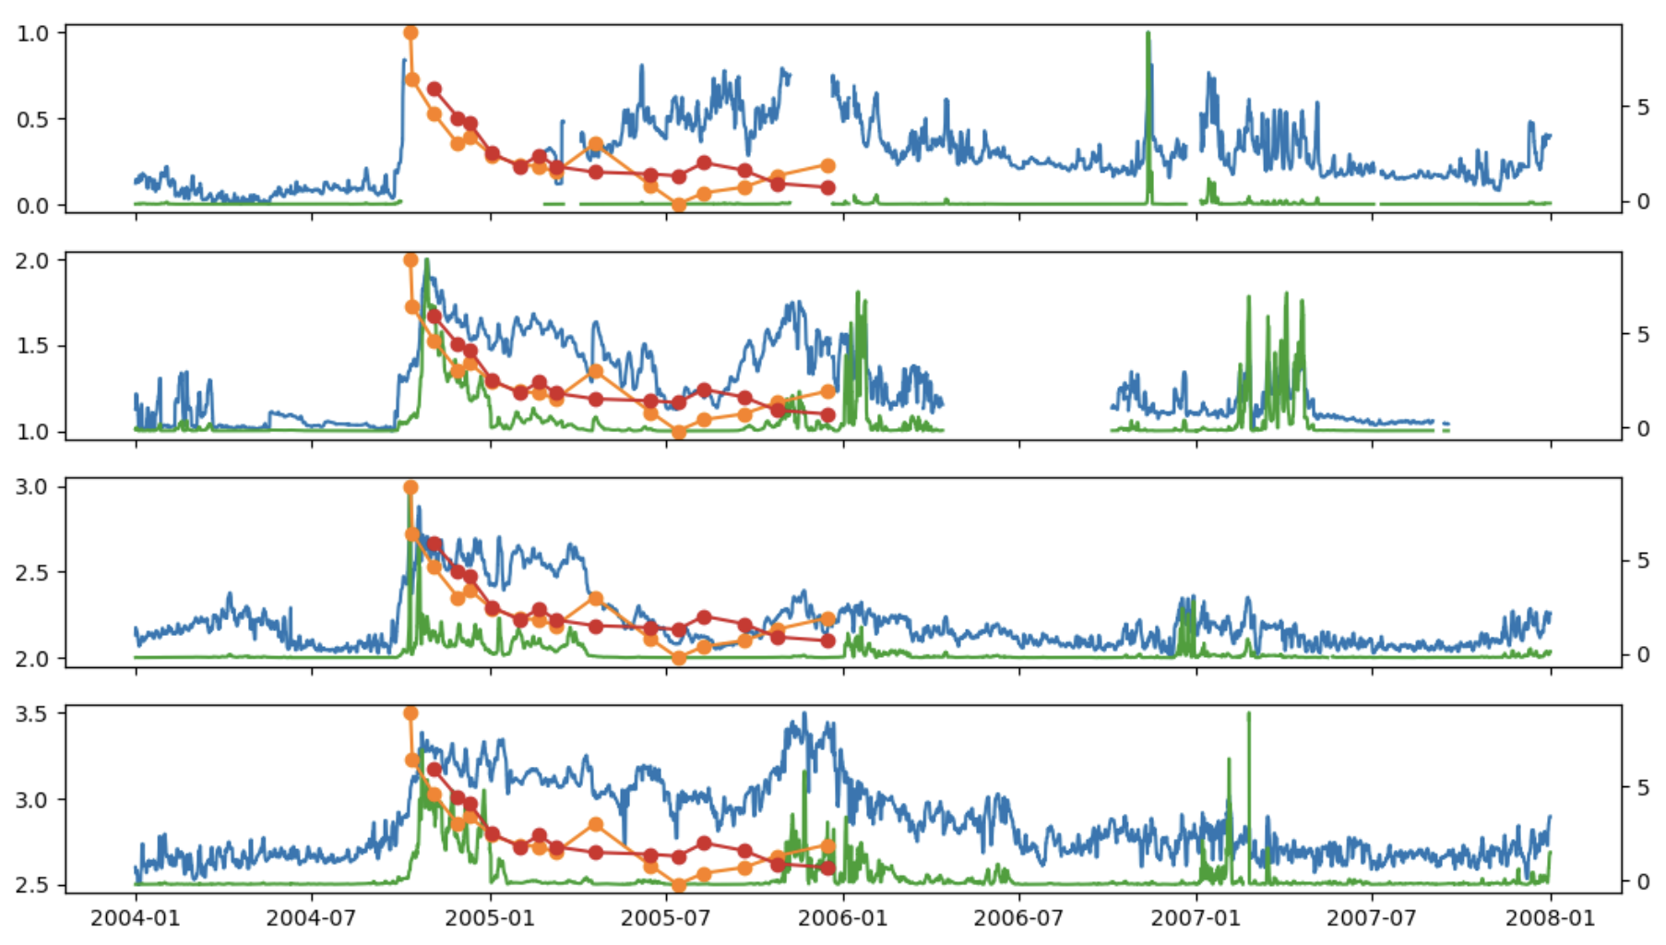
What figures do we expect?
Time series
Map
Animated map in time

Slide 12
PyGMT, Plotly, Geoplotlib, and Folium are all Python libraries used for geospatial data visualization, but they have different focuses and capabilities. Here's a comparison of these libraries:
1. **PyGMT (Python-Generic Mapping Tools):**
- **Focus:** PyGMT is primarily designed for creating high-quality static maps and figures for scientific and publication purposes.
- **Pros:**
- Offers a wide range of geospatial data processing and plotting capabilities.
- Provides access to the GMT library, which has a long history in geophysics and geospatial data processing.
- Highly customizable and supports a variety of map projections, basemaps, and geospatial data types.
- Allows users to create complex figures with ease.
- **Cons:**
- Steeper learning curve, especially for those new to the Generic Mapping Tools (GMT).
- Limited interactivity compared to other libraries.
2. **Plotly:**
- **Focus:** Plotly is a versatile library for interactive data visualization, including geospatial data.
- **Pros:**
- Offers interactive, web-based geospatial visualizations with features like zooming, panning, and hover tooltips.
- Integrates well with Jupyter notebooks and provides interactive dashboards.
- Supports various map types (scatter maps, choropleth maps, etc.).
- Suitable for a wide range of data visualization tasks beyond geospatial data.
- **Cons:**
- Less suitable for static, publication-quality maps compared to PyGMT.
- Customization options, especially in free versions, might be limited.
3. **Geoplotlib:**
- **Focus:** Geoplotlib is a library specifically designed for creating simple, interactive maps.
- **Pros:**
- Simple and easy-to-use for basic geospatial visualization tasks.
- Offers basic interactivity such as zooming, panning, and tooltips.
- Suitable for quick exploratory data analysis.
- **Cons:**
- Limited customization and advanced geospatial capabilities compared to PyGMT and Plotly.
- Best suited for simple, straightforward map visualizations.
4. **Folium:**
- **Focus:** Folium is a Python wrapper for Leaflet.js, used for creating interactive maps with minimal coding.
- **Pros:**
- Extremely easy to use and suitable for creating interactive maps with minimal coding.
- Well-suited for web applications and dashboards.
- Provides various built-in tilesets and the ability to overlay markers, polygons, and other map elements.
- **Cons:**
- May not be as feature-rich as other libraries in terms of geospatial capabilities.
- Limited functionality for complex geospatial analysis.
In summary, the choice of a geospatial library depends on your specific use case. If you need high-quality, publication-ready static maps, PyGMT is an excellent choice. If interactivity and web-based visualization are important, Plotly and Folium are good options. Geoplotlib is suitable for quick, simple visualizations where ease of use is a priority.

